Slide 1
MODULE 4: Control Flow: Conditionals and Loops
PTP5.101: Programmer's Mindset: Problem Solving and Programming

Slide 2
Conditionals
If blocks (Simple-If)
If-else block (if-else, else-if ladder, Nested-if, switch-case)

Slide 3
Conditionals
In programming, conditional statements are used to make decisions in the flow of execution based on whether a given condition is true or false.
In Scratch:
Scratch is a visual, block-based programming language designed primarily for beginners. It uses "if" blocks to implement conditionals.
The blocks represent different logic structures and are designed to be easy to drag, drop, and connect.

Slide 4
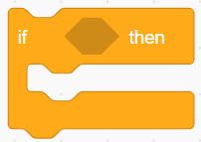
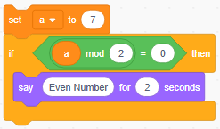
Basic If Statement
In Scratch, conditionals are represented by the “if” block. If the condition inside the block evaluates to “true”, the code inside the block is executed.
Example:
Check weather the number is even or odd

Slide 5
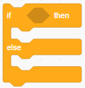
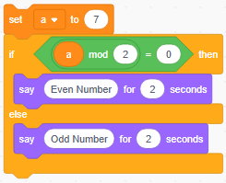
If-else Statement
The "if else" block is used when there are two possible actions: one if the condition is true and another if the condition is false.
Example: Check weather the number is even or odd

Slide 6
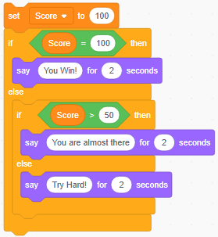
Else-if Statement
Scratch has an "if else" block, but it doesn't have an explicit "else if" block like in C. However, you can simulate an else if by nesting multiple "if" blocks.
Example: Create a variable name score and prompt
If score=100 [You Win!]
If score>=50 [You are almost there]
If score <50 [Try hard]

Slide 7
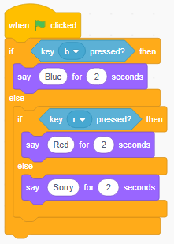
Switch-Case
Switch-case is an alternative to multiple else-if statements.
Scratch doesn't have a built-in switch-case block, but you can simulate similar behavior using multiple "if-else" blocks.
Example: Prompt the color selected
If b key is pressed [Blue]
If r key is pressed [Red]
If other key is pressed [Sorry]

Slide 8
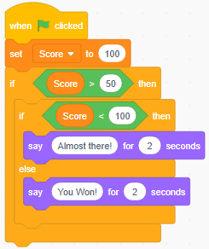
Nested-If
You can nest conditionals (putting an "if" block inside another "if" block) to create more complex decision-making logic.
Example: Create a variable name score and prompt
If score>50 [then check score < 100]
If score<100 [You are almost there]
If score =100 [You Won!]

Slide 9
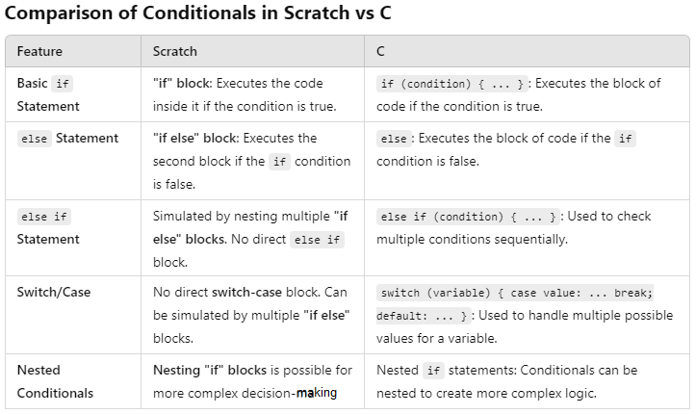
Comparison Scratch vs C

Slide 10
Loops
Forever
Repeat
Repeat - until
StopAll

Slide 11
Loops, and break Statements
Loops, break, and jump statements are fundamental for controlling the flow of execution in both Scratch. While both languages allow for the repetition of actions and provide ways to exit or skip parts of code, they do so in different ways.
Scratch provides several types of loops to repeat actions, such as:
"forever" loop: Repeats indefinitely.
"repeat" loop: Repeats a specific number of times.
"repeat until" loop: Repeats until a condition is met.

Slide 12


Forever Loop
For loop run indefinitely.
Example: Rotate a Sprite

Slide 13
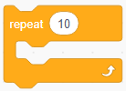
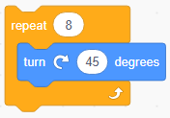
Repeat Loop
Repeat loop repeats for a fixed number of iterations
Example: Turn sprite 45 degrees a Sprite for 8 times

Slide 14

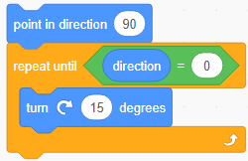
Repeat-Until Loop
Repeat – until the loop is a conditional loop it iterates till the condition becomes “false”.
Example: Turn the sprite 15 degrees till its x and y value is 0.

Slide 15
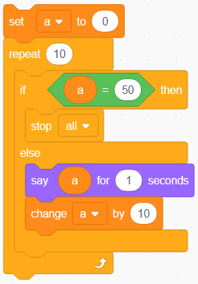

Stop Statement
Scratch does not have a direct break statement. However, the "stop all" block can be used to stop a script or loop.
Example: set a variable a to 0 and increment the
value by 10 and stop iteration when a = 50.

Slide 16
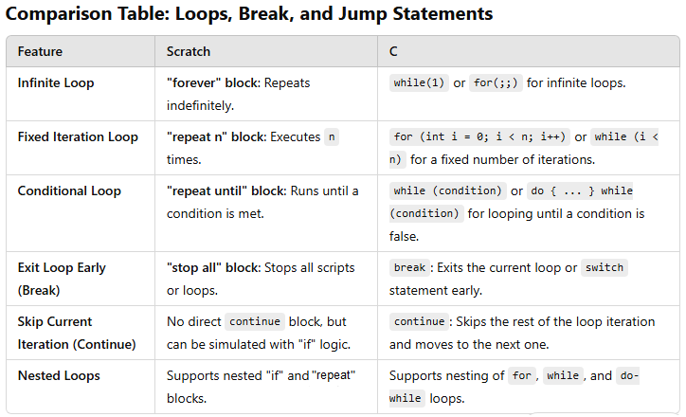
Comparison Scratch vs C

